Slide 1


Tinh Nhat Pham
1/1/2022

Slide 2

Outline
Executive Summary
Introduction
Methodology
Results
Conclusion
Appendix

Slide 3
Executive Summary
Summary of methodologies
Data collection
Data wrangling
EDA with data visualization
EDA with SQL
Build an Interactive Map with Folium
Build a Dashboard with Plotly Dash
Predictive Analysis (Classification)
Summary of all results
Exploratory data analysis results
Interactive analytics demo in screenshots
Predictive analysis results

Slide 4
Introduction
SpaceX advertises Falcon 9 rocket launches on its website with a cost of 62 million dollars; other providers cost upward of 165 million dollars each, much of the savings is because SpaceX can reuse the first stage.
Therefore if we can determine if the first stage will land, we can determine the cost of a launch. This information can be used if an alternate company wants to bid against SpaceX for a rocket launch
Problems you want to find answers
Discover new insights by analyzing Falcon 9 rocket launch data in the first stage.
Predict whether or not the first stage will successfully land.

Slide 5


Slide 6
Methodology
Executive Summary
Data collection methodology:
Describe how data was collected
Perform data wrangling
Describe how data was processed
Perform exploratory data analysis (EDA) using visualization and SQL
Perform interactive visual analytics using Folium and Plotly Dash
Perform predictive analysis using classification models
How to build, tune, evaluate classification models

Slide 7
Data Collection – SpaceX API
Key phrases:
Send request to get rocket launch data from SpaceX website
Receive response from the SpaceX website
Parse response JSON and store in to Pandas Dataframe
GitHub URL: Click here
API
python
request
SpaceX web source
response
Pandas Dataframe

Slide 8
Data Collection - Scraping
Wikipedia website
SpaceX rocket launch record tables
Key phrases:
Send request to get rocket launch record tables from SpaceX Wikipedia
Receive response from the SpaceX Wikipedia
Parse response content using BeautifulSoup API
Store data into Pandas Dataframe
GitHub URL: Click here
request
response
Python
BeautifulSoup
Pandas Dataframe

Slide 9
Data Wrangling
Key phrases:
Calculate the number of launches on each site
Calculate the number and occurrence of each orbit
Calculate the number and occurrence of mission outcome per orbit type
Create a landing outcome label from Outcome column
Determine the successful rate
GitHub URL: Click here

Slide 10
Data Wrangling (cont.)
The number of launch each sites
The number and occurrence each orbit
The number and occurrence mission Outcome per Orbit type
Determine the successful rate
Create landing outcome labe
The number and occurrence mission Outcome per Orbit type

Slide 11
EDA with Data Visualization
Scatter plot: FlightNumber vs PayMassLoad
Check the relationship between flight number vs rocket payload mass based on landing outcome
Scatter plot: FlightNumber vs Launch Site
Check the relationship between flight number vs launch sites based on landing outcome
Scatter plot: PayloadMass vs Launch Site
Check the relationship between flight number vs launch sites based on landing outcome

Slide 12
EDA with Data Visualization (cont.)
Bar plot: Successful rate vs Orbit
Visualize the relationship between successful rate of each orbit type
Scatter plot: FlightNumber vs Orbit type
Visualize the relationship between Flight number and Orbit type
Scatter plot: PayloadMass vs Orbit type
Visualize the relationship between Payload mass and Orbit type
Line plot: Successful rate over the years (2010 - 2020)
Visualize the successful rate from 2010 - 2020, which kept increasing since 2013 till 2020
GitHub URL: Click here

Slide 13
EDA with SQL
Query the names of the unique launch sites in the space mission
Query the names of the unique launch sites in the space mission
Query 5 records where launch sites begin with the string 'CCA'
Query the total payload mass carried by boosters launched by NASA (CRS)
Query average payload mass carried by booster version F9 v1.1
List the date when the first successful landing outcome in ground pad was achieved.

Slide 14
EDA with SQL (cont.)
List the names of the boosters which have success in drone ship and have payload mass greater than 4000 but less than 6000
List the total number of successful and failure mission outcomes
List the names of the booster_versions which have carried the maximum payload mass. Use a subquery
List the failed landing_outcomes in drone ship, their booster versions, and launch site names for in year 2015
Rank the count of landing outcomes (such as Failure (drone ship) or Success (ground pad)) between the date 2010-06-04 and 2017-03-20, in descending order
GitHub URL: Click here

Slide 15
Build an Interactive Map with Folium
Create circle object to show the location of NASA center and marker to show the name NASA JSC on the folium map
Create circle objects to show the locations of Launch Sites and marker objects to show the names of the Launch Sites on the folium map
Create marker objects to show the success/failed launches for each site on the map, and add to the Cluster marker object
Calculate the distances between the CCAFS SLC-40 to the nearest coastline, highway, rainway, and city. Then draw the lines of the distances.
GitHub URL: Click here

Slide 16
Build a Dashboard with Plotly Dash
Summarize what plots/graphs and interactions you have added to a dashboard
Explain why you added those plots and interactions
Add drop down list of Launch sites
Add a pie chart to show the success/failed launch rate when choosing the site from drop down list
Add a slider to choose the minimum and maximum payload mass
Add a scatter plot to show the success/failed launches when choosing the site from drop down list and the min/max payload mass from slider
GitHub URL: Click here

Slide 17
Predictive Analysis (Classification)
Load the data and store in Pandas Dataframe
Create features (X) and target (Y)
Standardize the features X
Create Train set and Test set by using X and Y
Using GridSearchCV to find the best parameters for each classifier:
Logistic Regression
Support Vector Machine
Decision Tree
K Nearest Neighbors
Calculate performance score each classifier by predict Test set.
Evaluate the best performing classification model.
GitHub URL: Click here

Slide 18
Predictive Analysis (Classification) (cont.)
Test set
Data
Training set
Algorithm
Evaluation
Best model
Model Development Process

Slide 19
Results
Exploratory data analysis results
Interactive analytics demo in screenshots
Predictive analysis results

Slide 20


Slide 21
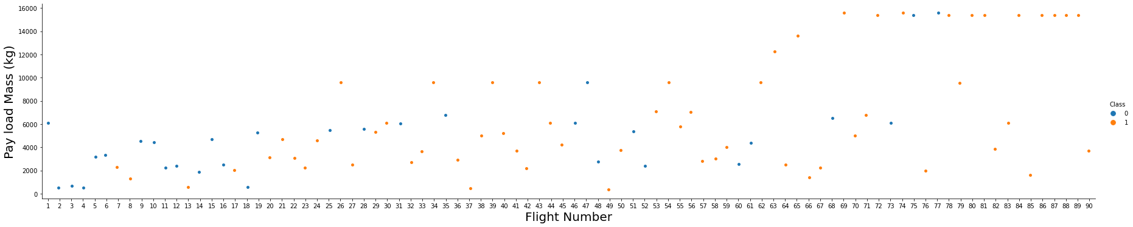
Flight Number vs. Payload Mass
The plot shows that as the number of flights increases, so does the likelihood of a successful landing.
The greater the payload mass, the better the landing outcome.

Slide 22
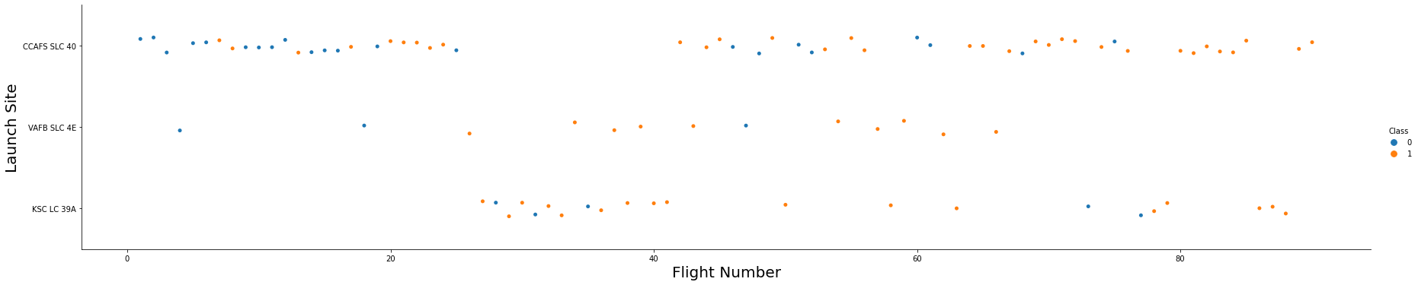
Flight Number vs. Launch Site
The higher flight number the more success.
CCAFS SLC 40 launch site has the lowest successful rate (60%)
VAFB SLC 4E and KSC LC 39A has the most successful rate (77%)

Slide 23
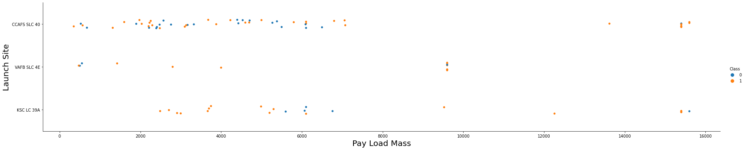
Payload vs. Launch Site
The VAFB-SLC launchsite there are no rockets launched for heavy payload mass (greater than 10000)
The CCAFS SLC 40 launch site has the most rockets launched, but mostly below 8000
The KSC LC 39A has the most successful rate compare to other sites

Slide 24
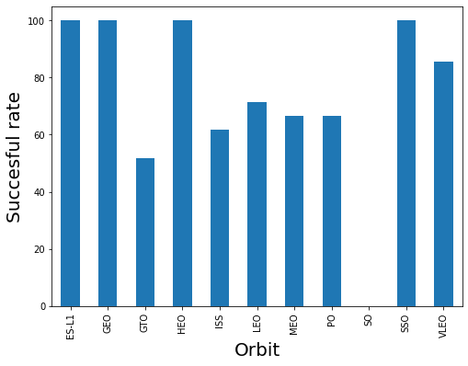
Success Rate vs. Orbit Type
ES-L1, GEO, HEO, SSO are the orbits that have 100% success rate.
GTO is the orbit that has lowest success rate (about 55%)
ISS, LEO, MEO, PO orbits have similar success rate (60%-70%)

Slide 25
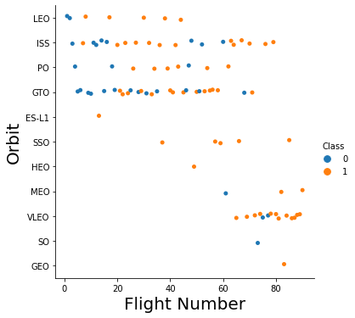
Flight Number vs. Orbit Type
LEO is the only orbit where the success rate is related to the amount of flights.
In other orbits, there is no relationship between success rate and flight number.

Slide 26
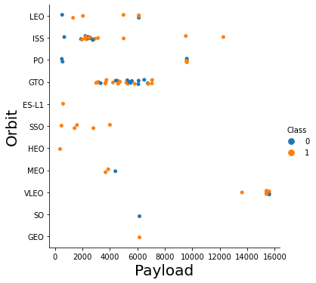
Payload vs. Orbit Type
We can see that LEO, ISS, and PO have a higher success rate when the payload mass is large.
There is no relationship between success rate and payload in other orbits.

Slide 27
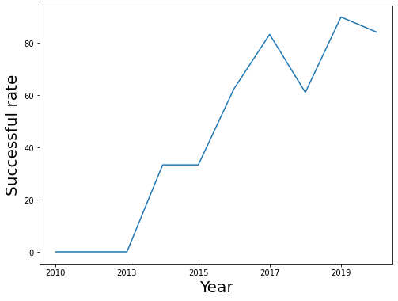
Launch Success Yearly Trend
The success rate kept increasing since 2013.
The reasons could be the improvement after each failure and the advancement of technology over time.

Slide 28
All Launch Site Names
Find the names of the unique launch sites
%%sql
select distinct LAUNCH_SITE
from SPACEXDATASET
Use the keyword distinct to select the unique launch sites

Slide 29
Launch Site Names Begin with 'CCA'
Find 5 records where launch sites begin with `CCA`
%%sql
select distinct LAUNCH_SITE
from SPACEXDATASET
where launch_site like 'CCA%'
Use distinct and where to select the launch sites with the name starts with CCA

Slide 30
Total Payload Mass
Calculate the total payload carried by boosters from NASA
%%sql
select sum(PAYLOAD_MASS__KG_) as total_payload_mass
from SPACEXDATASET
where CUSTOMER = 'NASA (CRS)'
Use sum function to summary the total payload mass and where statement to apply condition (customer is NASA)

Slide 31
Average Payload Mass by F9 v1.1
Calculate the average payload mass carried by booster version F9 v1.1
%%sql
select avg(PAYLOAD_MASS__KG_) as average_payload_mass
from SPACEXDATASET
where BOOSTER_VERSION = 'F9 v1.1'
Use avg function to calculate the average of payload mass and where statement to apply condition (BOOSTER_VERSION is F9 v1.1)

Slide 32
First Successful Ground Landing Date
Find the dates of the first successful landing outcome on ground pad
%%sql
select min(DATE)
from SPACEXDATASET
where LANDING__OUTCOME = 'Success (ground pad)'
Use min function to get the first date (minimum) of the first successful landing outcome on ground pad.
Use where statement to apply condition (LANDING__OUTCOME is Success (ground pad))

Slide 33
Successful Drone Ship Landing with Payload between 4000 and 6000
List the names of boosters which have successfully landed on drone ship and had payload mass greater than 4000 but less than 6000
%%sql
select BOOSTER_VERSION
from SPACEXDATASET
where LANDING__OUTCOME = 'Success (drone ship)' and (PAYLOAD_MASS__KG_ > 4000 and PAYLOAD_MASS__KG_ < 6000)
Use the comparison operators > and < to select the PAYLOAD_MASS__KG_ that greater than 4000 but less than 6000

Slide 34
Total Number of Successful and Failure Mission Outcomes
Calculate the total number of successful and failure mission outcomes
%%sql
select MISSION_OUTCOME, count(MISSION_OUTCOME) as total
from SPACEXDATASET
group by MISSION_OUTCOME
Use count function to count the number of mission outcomes, and using group by statement to group the value by the mission outcomes.

Slide 35
Boosters Carried Maximum Payload
List the names of the booster which have carried the maximum payload mass
%%sql
select BOOSTER_VERSION
from SPACEXDATASET
where PAYLOAD_MASS__KG_ = (select max(PAYLOAD_MASS__KG_) from SPACEXDATASET)
Use the subquery to return the maximum payload mass(max function) and get the booster version that has the payload equal to the maximum payload mass

Slide 36
2015 Launch Records
List the failed landing_outcomes in drone ship, their booster versions, and launch site names for in year 2015
%%sql
select LANDING__OUTCOME, BOOSTER_VERSION, LAUNCH_SITE
from SPACEXDATASET
where year(DATE) = 2015 and LANDING__OUTCOME = 'Failure (drone ship)'
Use year function to extract the year from DATE to select the year in 2015

Slide 37
Rank Landing Outcomes Between 2010-06-04 and 2017-03-20
Rank the count of landing outcomes (such as Failure (drone ship) or Success (ground pad)) between the date 2010-06-04 and 2017-03-20, in descending order
%%sql
select LANDING__OUTCOME, count(LANDING__OUTCOME) as total
from SPACEXDATASET
where DATE between '2010-06-04' and '2017-03-20'
group by LANDING__OUTCOME
order by total desc
Use between operator to get the date from 2010-06-04 and 2017-03-20.
Use group by statement to group result by landing outcome
Use order by statement with desc to sort the result in descending total order.

Slide 38


Slide 39
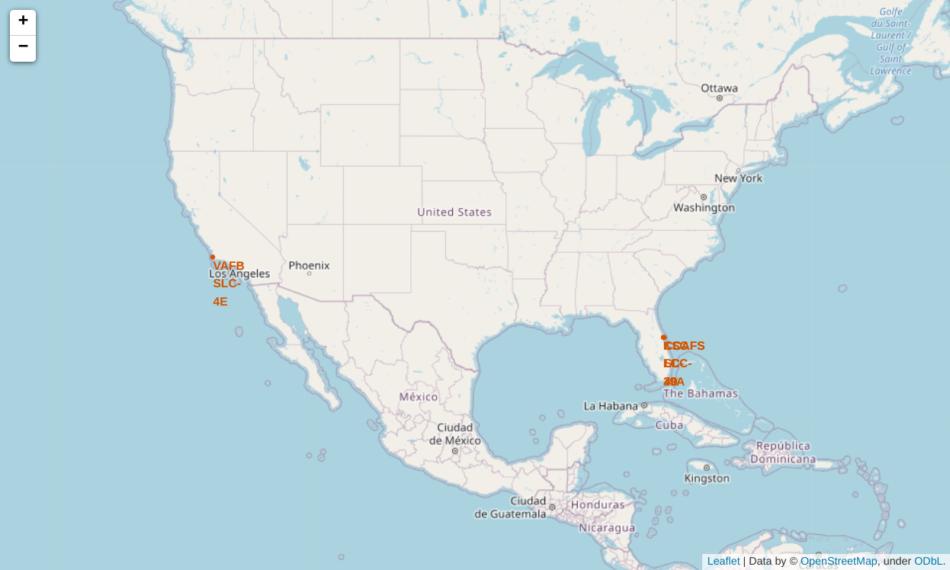
Launch site locations
All the launch sites in proximity to the Equator line, it's because of the rotational speed of Earth that helps the launch.
All the launch sites is located very close to the coast to reduce the risks over populated areas.

Slide 40
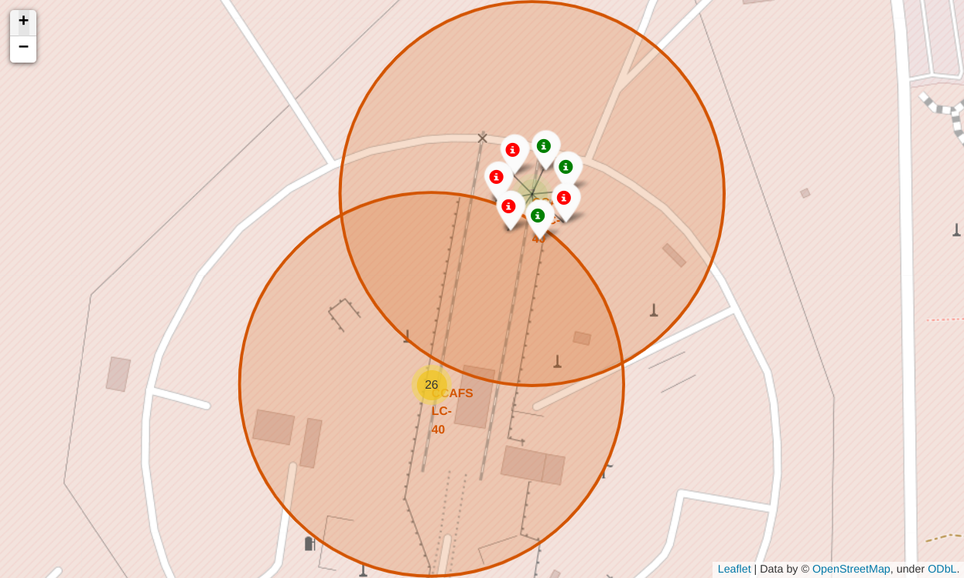
Landing outcome on each landing site
Based on the color-labeled markers in marker clusters, we can see the KSC LC-39A has the most successful landing outcome (10 success out of 13 landings)
CCAFS LC-40 has the lowest success rate, with 19 failures out of 26 landings.

Slide 41
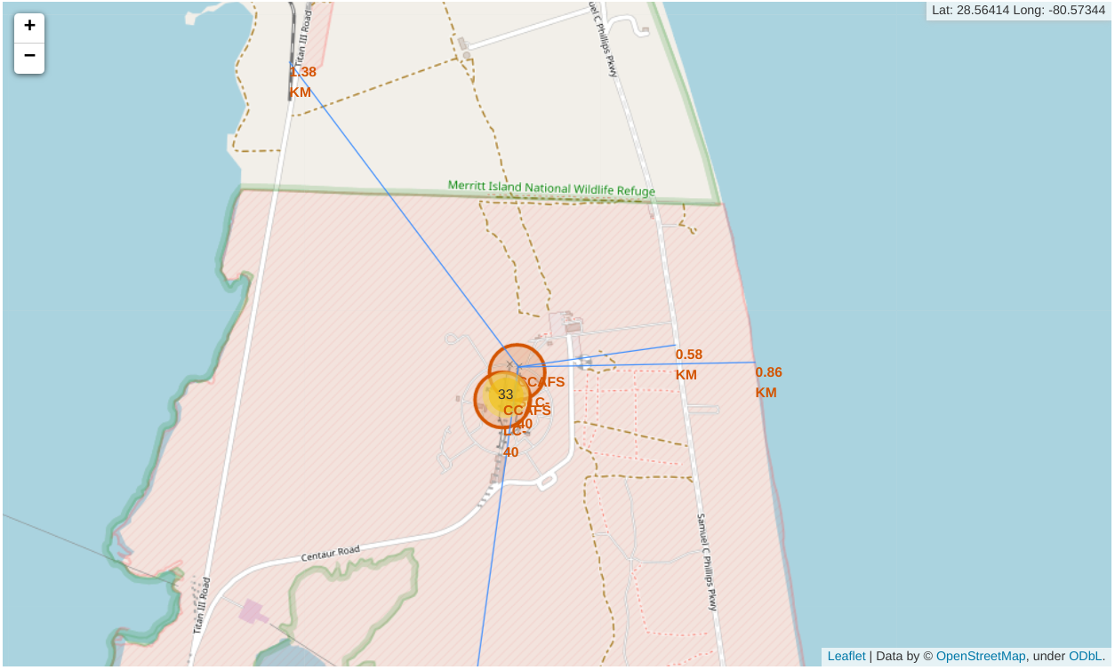
Launch site vs its proximities
The launch site (CCAFS SLC-40) in close proximity to railway: 1.38 Km
The launch site (CCAFS SLC-40) in close proximity to highway: 0.58 Km
The launch site (CCAFS SLC-40) in close proximity to coastline: 0.86 Km
The launch site (CCAFS SLC-40) keeps 49.86 Km away from Melbourne city

Slide 42


Slide 43
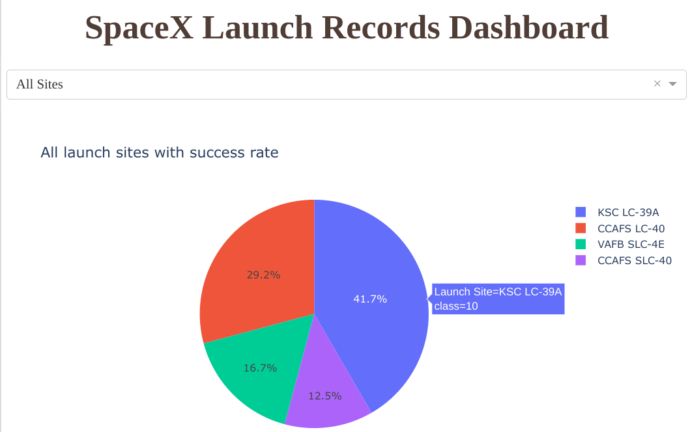
Launch sites success rate
The KSC LC-39A has the highest landing success rate (41.7 percent of total rate).
CCFS SLC-40 has the lowest landing success rate (12.5%)

Slide 44
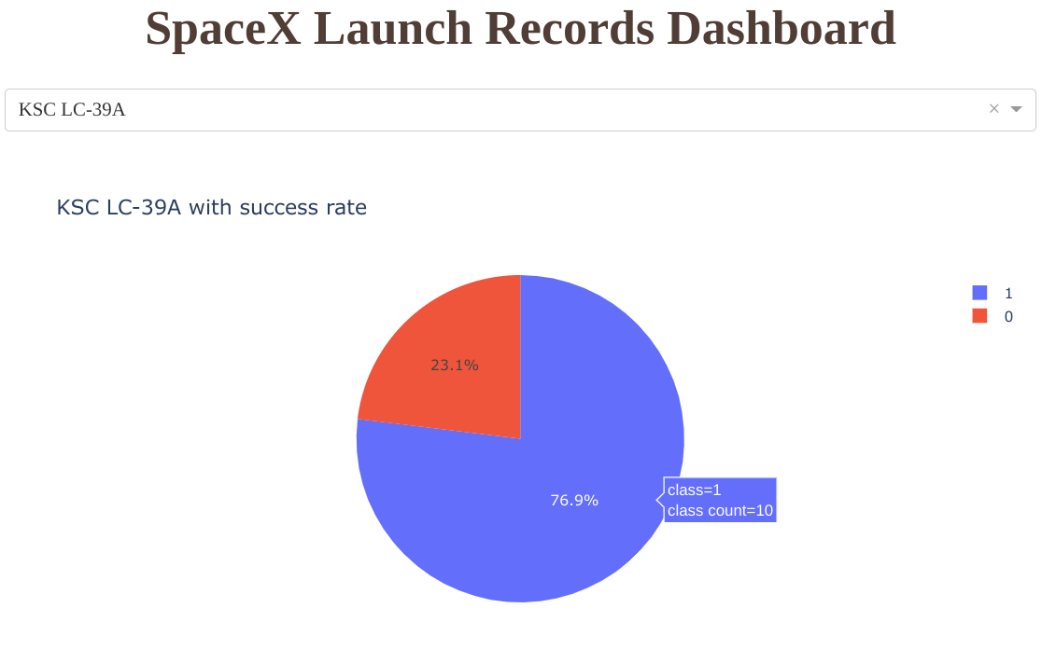
Launch site - success ratio
KSC LC-39A has the highest launch success ration (76.9% success vs 23.1% fail).

Slide 45
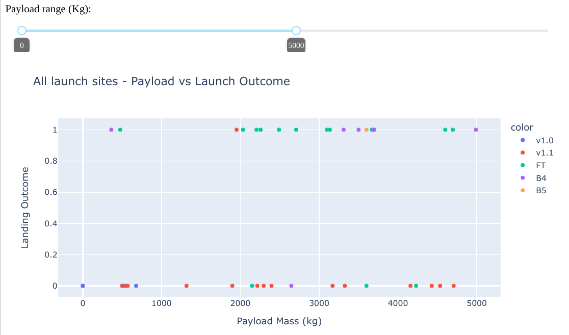
Success rate - Payload vs Landing outcome
Payload range 0 - 5000: FT version have the largest success rate vs V1.1 version has the most failure rate.

Slide 46
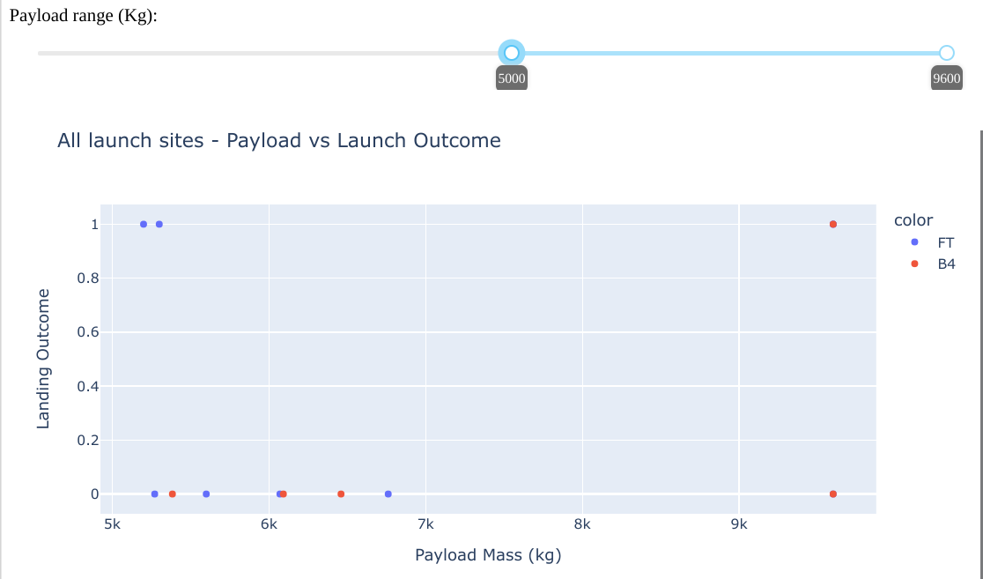
Success rate - Payload vs Landing outcome
Payload range 5000 - 9600: FT version have the most success rate vs B4 version has the most failure rate.
In heavy payload mass, only FT and B4 boosters are used (greater than 5000 kg).

Slide 47


Slide 48
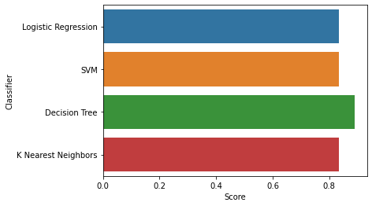
Classification Accuracy
As the chart shows, the Decision Tree classifier has the highest score (88% accuracy)

Slide 49
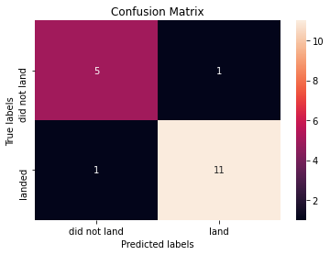
Confusion Matrix
The confusion matrix plot shows the accuracy of the model predictions:
11 True Positives vs 1 False Negative
5 True Negatives vs 1 False Positive

Slide 50
Conclusions
The greater payload mass, the better landing outcome.
KSC LC-39A has the most success rate compare to others.
ES-L1, GEO, HEO, SSO are the orbits that have 100% success rate.
The reasons could be the improvement after each failure and the advancement of technology over time.
All the launch sites in proximity to the Equator line
All the launch sites is located very close to the coast to reduce the risks over populated areas.
The Decision Tree Classifier is the best model.

Slide 51
Appendix
Use seaborn heatmap plot to show the correlation in the dataset.
Show the flight number over the year.

Slide 52
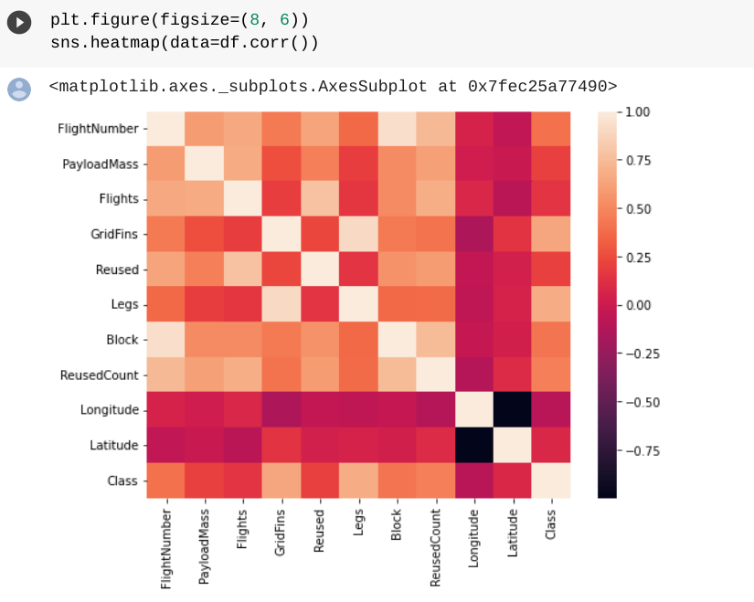
Appendix

Slide 53
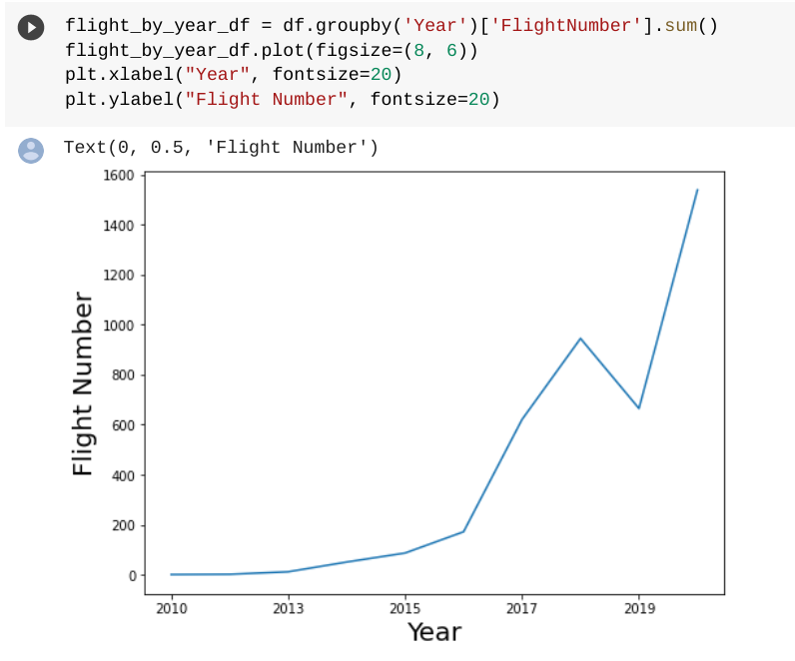
Appendix

Slide 54


